Slide 1
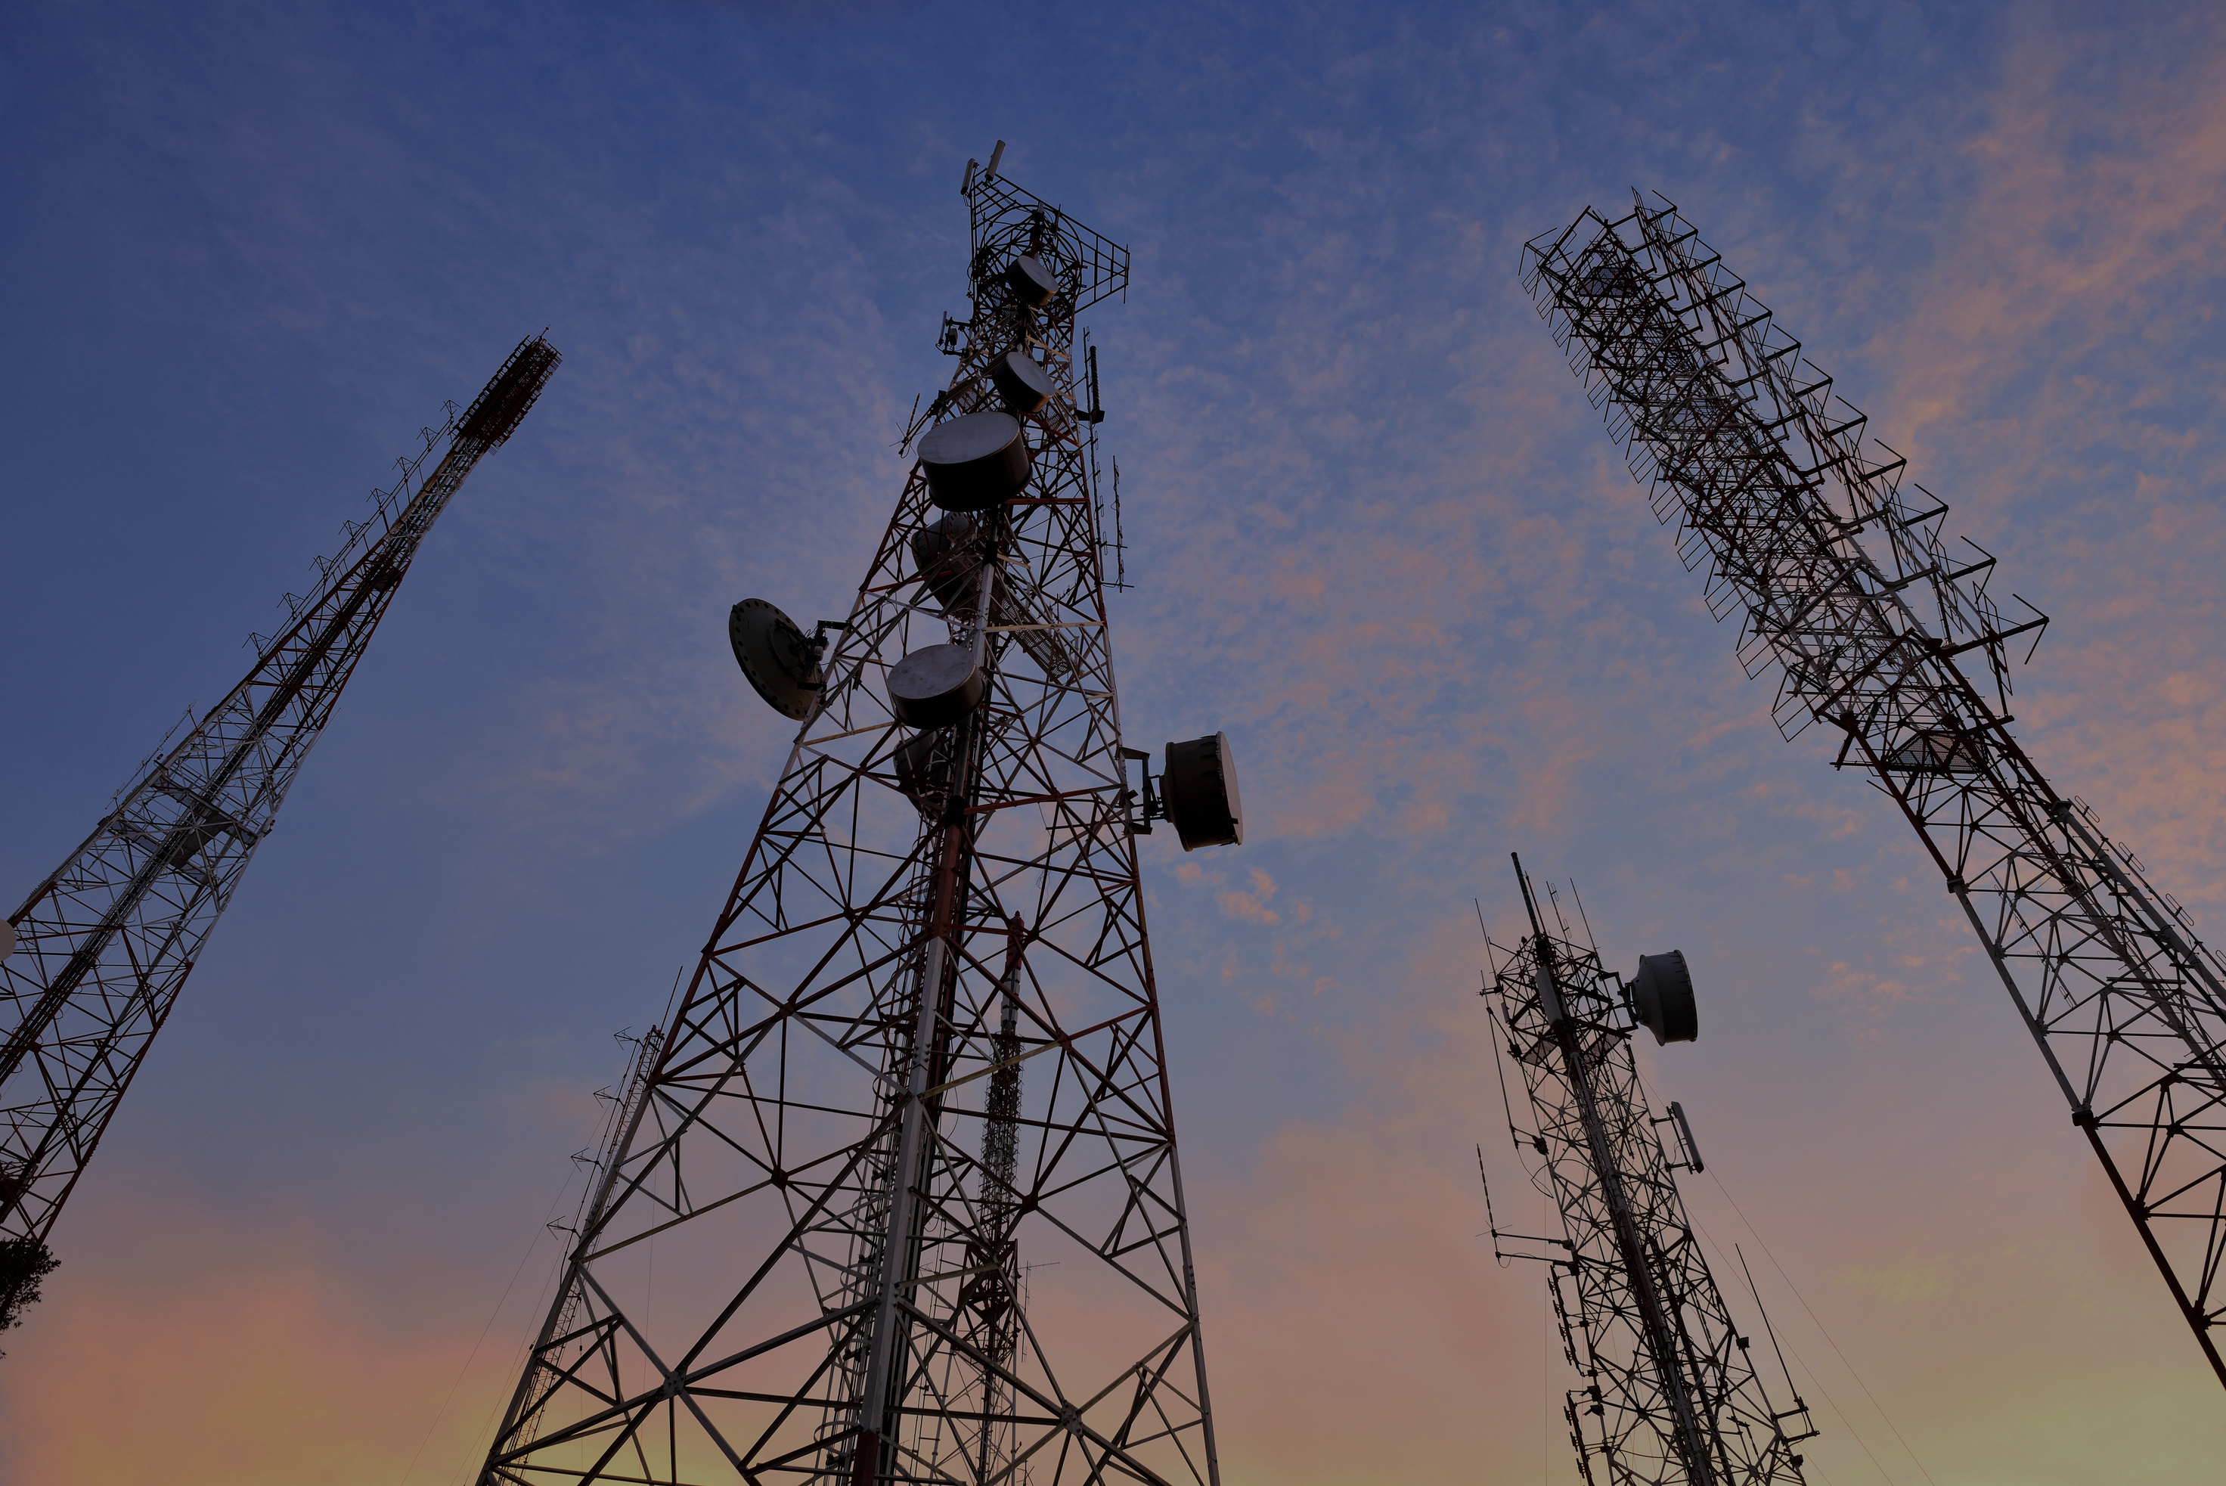
SYRIA
TEL
DATA ANALYSIS PROJECT
GROUP 8

Slide 2
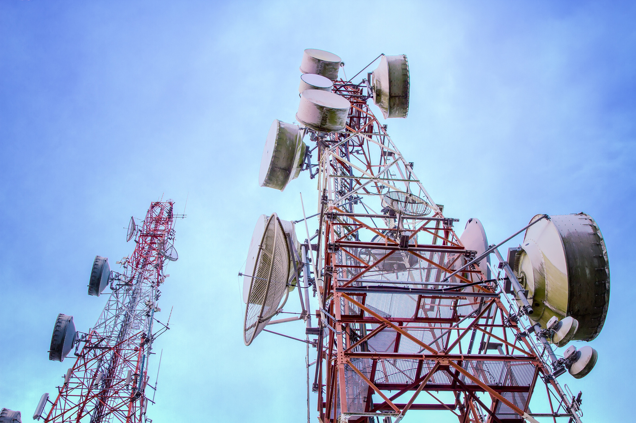
PROJECT SUMMARY
In response to SyriaTel's pressing need to address customer churn, we propose developing a robust classifier to predict customer attrition. Leveraging predictive analytics, our goal is to uncover discernible patterns within SyriaTel's telecommunications data. By employing advanced machine learning techniques, specifically binary classification, we aim to equip SyriaTel with a predictive model capable of identifying customers likely to churn in the near future. Our primary focus is on assisting SyriaTel in minimizing revenue loss by proactively addressing customer retention. Through this project, we aim to unlock actionable insights that will empower SyriaTel to implement targeted strategies to mitigate customer churn, ultimately fostering long-term business sustainability.
CLICK HERE

Slide 3


OUTLINE
1) Business Problem
2) Data
3) Methods
4) Results
As a source of social and cultural status
Livestock products include meat, milk, eggs, and clothing (such as wool).

Slide 4

PROJECT
GOALS
Customer churn poses a significant challenge for companies, directly impacting revenue. In the competitive telecommunications industry, like SyriaTel, churn is prevalent. We aim to create predictive models to anticipate and prevent churn, supporting SyriaTel's retention strategies.

Slide 5

DATA
Our Data comes from Syriatel Telecommunications.
It is a file containing customer service data from its various past and present customers.
It comprises of the following from each individual customer;
state, account length, area code, phone number, international plan, voice mail plan, number vmail messages, total day, minutes, total day calls, total day charge, total evening minutes ,total evening calls, total evening charge, total night minutes, total night, calls, total night charge, total international minutes, total international calls, total international charge, customer service calls and churn
CLICK HERE

Slide 6

METHOD
Data analysis method: Process of examining, cleansing, transforming, and modeling data to discover useful information, inform conclusions, and support decision-making.
1) Data Loading and understanding
2) Data Preparation
3) Distribution of data
4) Data Pre-processing
5) Model development and evaluaion
6) Model Optimization

Slide 7

RESULTS
From our analysis we were able to find out that the following variables had an effect on the churn rate of customers;
Total Day Minutes
tthe total number of calling minutes used during the day
Total International Minutes
the total number of international minutes
Total Day Charge
the billed cost of daytime calls
Total Evening Charge
the billed cost of evening time calls
Customer Service calls
the number of calls placed to Customer Service
International Calls
the total number of international calls
Total Charge
Sum of Day Charge , Evening Charge, Night Charge and Internationall Charge.

Slide 8

RESULTS
Our analysis of Syriatel's telecommunication service data revealed that the Random Forest Classifier outperformed other methods, demonstrating superior accuracy for classification tasks.
Think of the Random Forest Classifier as a diverse team of experts providing valuable insights. By combining their opinions, it ensures reliable predictions, aiding in strategic business decisions with confidence. (In your case, it will allow you to know which customers are most likely to churn)

Slide 9
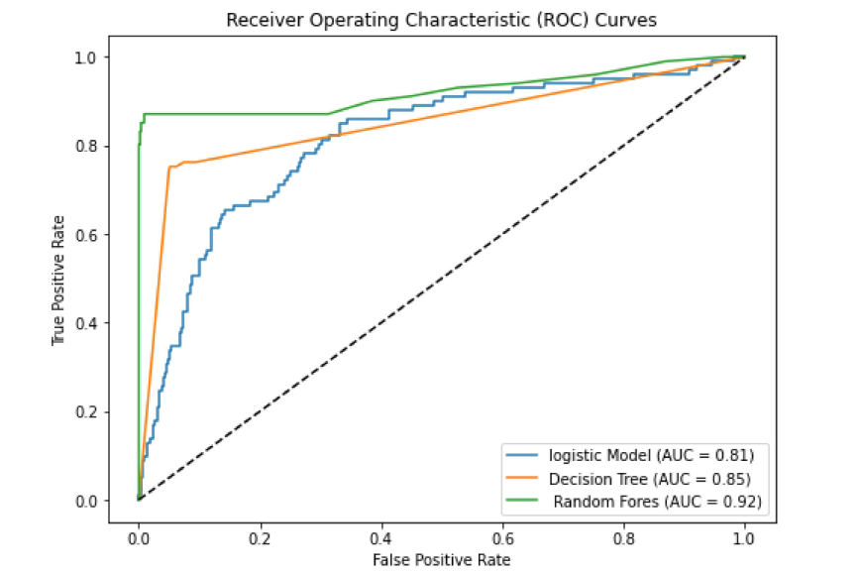
Why Random
Forest?
Our investigation led us to selecting Random Forest as the ideal candidate. Its standout quality lies in achieving the highest AUC score, demonstrating its capability to fulfill our requirements effectively.

Slide 10

Recommendations
Implement discounts and offers to incentivize customers and lower churn rates. Additionally, consider reducing call charges for enhanced customer satisfaction.
Elevate customer service standards by refining training programs for service agents. Empower them to deliver efficient and high-quality assistance to address customer concerns promptly.
Enhance network coverage and service quality to mitigate the volume of customer service calls. Prioritize improvements to ensure seamless and reliable service delivery to customers.

Slide 11
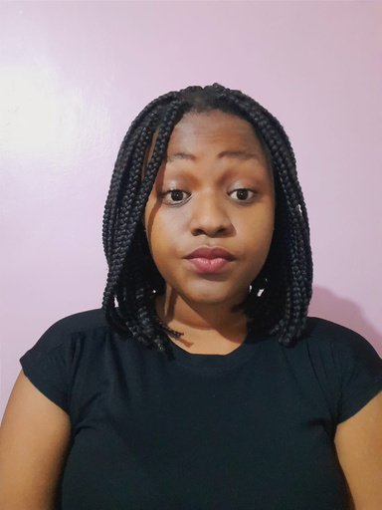
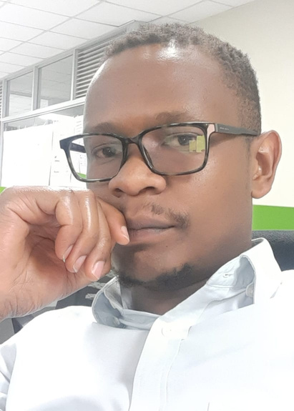
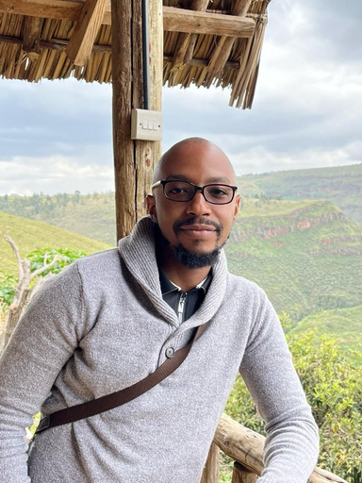
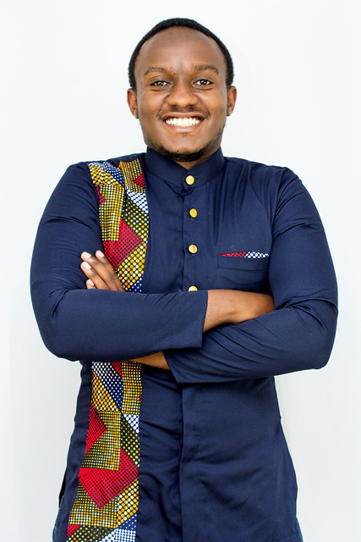
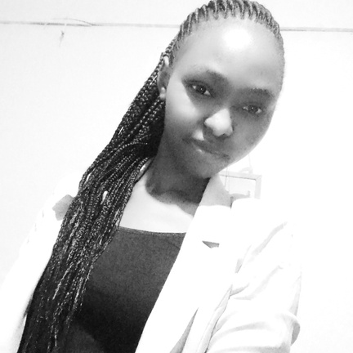
Sydney Mumbo
James Ndiritu
Brian Kanyotu
Our Team Members
Chair
Nicholas Njubi
Chepkemoi Mercy
GROUP 8

Slide 12
THANK
YOU
TILL NEXT TIME!

